Slide 1
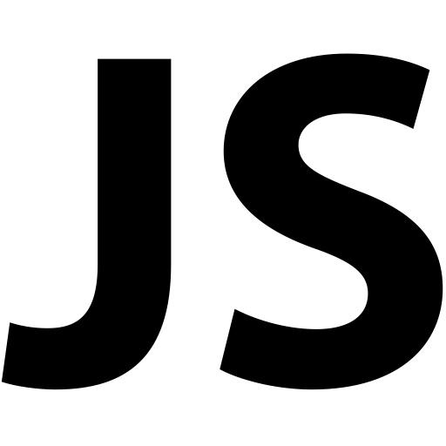
JavaScript
jQuery, AJAX
SoftUni Team
Technical Trainers
Software University
http://softuni.bg
Notes:
© Software University Foundation – http://softuni.org
This work is licensed under the Creative Commons Attribution-NonCommercial-ShareAlike license.
<number>

Slide 2
Table of Contents
JavaScript
What’s JavaScript?
Functions
jQuery
Asynchronous Programming
Promises
AJAX
<number>
Notes:
© Software University Foundation – http://softuni.org
This work is licensed under the Creative Commons Attribution-NonCommercial-ShareAlike license.
<number>

Slide 3
Have a Question?
sli.do #java-web
<number>

Slide 4
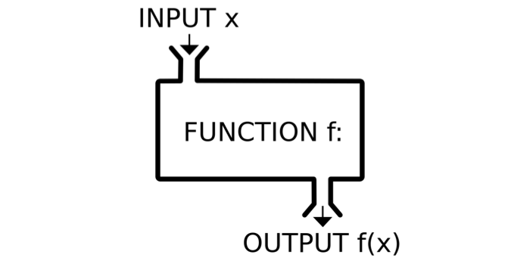
JavaScript
Functions - Syntax, Invocation, Return, Functions as values

Slide 5
JavaScript Syntax
The JavaScript syntax is similar to C#, Java and PHP
Operators, Variables, Conditional statements, loops,
functions, arrays, objects and classes
Declare a variable with let
let a = 5;
let b = 10;
if (b > a) {
console.log(b);
}
Body of the conditional statement
Conditional statement
<number>
Notes:
<number>

Slide 6
Functions in JS
Why Functions?
You can reuse code, define once, use many times.
Function = block of code
Can take parameters and return result
Function name: use camelCase
Function parameters: use camelCase
function printStars(count) {
console.log("*".repeat(count));
}
The { stays at the same line
Invoke the function
printStars(10);

Slide 7
Functions in JS (2)
function sum (a, b) {
console.log(a + b);
}
sum (5, 6); // 11
Invoke the function with different parameters value
function sum (a, b = 3) {
console.log(a + b);
}
sum (11); // 14
Default function parameters
function sum (a, b) {
return a + b;
}
let c = sum (5.8, 3);
console.log (c); // 8.8
Return ends function execution

Slide 8
Function Declaration, Expression, Arrow
function walk() {
console.log('walking');
}
walk(); // walking
Function Declaration
let solve = function walk() {
console.log('walking');
}
solve(); // walking
Function Expression
let solve = () => {
console.log('walking');
}
solve(); // walking
Arrow function

Slide 9
Function Invocation
The code inside a function is executed when the function is invoked with () operator
Invoke the function after declaration
function write(name) {
console.log(`I am ${name}`);
}
write('George'); // I am George
write('George'); // I am George
function write(name) {
console.log(`I am ${name}`);
}
Invoke the function before declaration

Slide 10
Function Invocation (2)
Anonymous self-invoking function
(function (count) {
for (let i = 1; i <= count; i++)
console.log('+'.repeat(i));
})(4);
+
++
+++
++++
This is called "closure" (a state is closed inside)
let f = (function () {
let x = 0;
return function() { console.log(++x); }
})(); f(); f(); f(); f();
1
2
3
4

Slide 11
Function Return
Return statement ends function execution
function getRectArea(width, height) {
if (width > 0 && height > 0) {
return width * height;
}
return 0;
}
console.log(getRectArea(3, 4)); // 12
console.log(getRectArea(-3, 4)); // 0
let result = function (a, b) {
return a % b;
};
console.log(result(10, 3)); // 1

Slide 12
Variables Holding Functions
In JS variables can hold functions as their values
let f = function(x) { return x * x; }
console.log(f(3)); // 9
console.log(f(5)); // 25
f = function(x) { return 2 * x; }
console.log(f(3)); // 6
console.log(f(5)); // 10
f = undefined;
console.log(f(3)); // TypeError: f is not a function(…)

Slide 13
Functions as Parameters
function repeatIt(count, func) {
for (let i = 1; i <= count; i++)
func(i);
}
let starsFunc = function(i) {
console.log('**'.repeat(i))
};
repeatIt(3, starsFunc);
repeatIt(3, function(x) {
console.log(2 * x);
});
**
****
******
2
4
6

Slide 14

jQuery
<number>

Slide 15
jQuery Selectors
jQuery selection is the same as the querySelector in Vanilla JS
All selector
Class selector
Element selector
Id selector
Multi-selector
$('*') // Selects all elements
$('.class') // Select by class name
$('section') // Select by tag name
$('#id') // Selects a element by given id
$('selector1, selector2') // Combined
<number>
Notes:
© Software University Foundation – http://softuni.org
This work is licensed under the Creative Commons Attribution-NonCommercial-ShareAlike license.
<number>

Slide 16
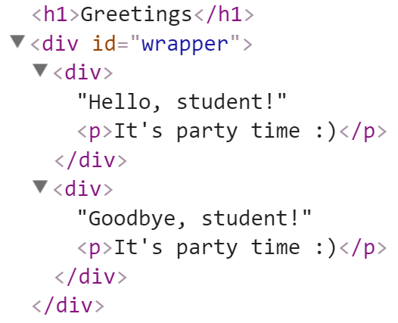
Adding Elements with jQuery
Select the parent element, then use:
append() / prepend()
appendTo() / prependTo()
<div id="wrapper">
<div>Hello, student!</div>
<div>Goodbye, student!</div>
</div>
$('#wrapper div').append("<p>It's party time :)</p>");
$('<h1>Greetings</h1>').prependTo('body');
<number>

Slide 17
jQuery Events: Attach / Remove
Attaching events on certain elements
$('a.button').on('click', buttonClicked);
function buttonClicked() {
$('.selected').removeClass('selected');
$(this).addClass('selected');
// "this" is the event source (the hyperlink clicked)
}
Removing event handler from certain elements
$('a.button').off('click', buttonClicked);
<number>

Slide 18
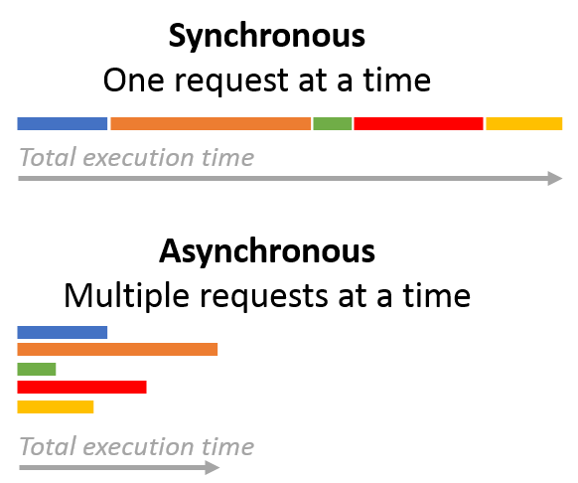
Asynchronous Programming

Slide 19
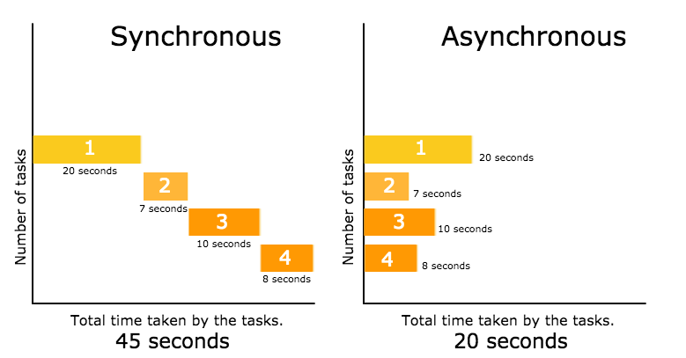
Asynchronous Programming
Asynchronous programming deals with the needs to run several tasks (pieces of code) in parallel, in the same time
<number>

Slide 20
Asynchronous Programming
Synchronous programming
Each line of code is executed only when the preceding line has finished it’s work
Asynchronous Programming
In asynchronous programs, you can have two lines of code (L1 followed by L2), where L1 schedules some task to be run in the future, but L2 runs before that task completes
The tasks may finish in order of execution but it is not guaranteed
<number>

Slide 21
Asynchronous Programming – Example
// Say "Hello."
console.log('Hello.');
// Say "Goodbye" two seconds from now.
setTimeout(function() {
console.log('Goodbye!');
}, 2000);
// Say "Hello again!"
console.log('Hello again!');
function getData() {
var data;
$.get('example.php', function(response) {
data = response;
}
);
return data;
}
var data = getData();
console.log('The data is: ' + data);
What is wrong with these examples?
<number>

Slide 22

Promises
.then()
.catch()
Promises in JS
Objects Holding Asynchronous Operations

Slide 23
What is a Promise?
A promise is an object holding an asynchronous operation
A result which may be available now, or in the future, or never
Promises let asynchronous methods return values like synchronous methods, instead of immediately returning the final value, the asynchronous method returns a promise to supply the value at some point in the future
Promises may be in one of these states:
Pending – operation still running (unfinished)
Fulfilled – operation finished (and the result is available)
Failed – operation is failed (and an error is available)
Promises in JS use the Promise object
<number>

Slide 24
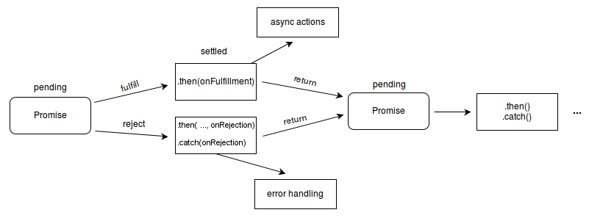
What is a Promise?
<number>

Slide 25

AJAX
Asynchronous JavaScript And XML

Slide 26
What is AJAX?
AJAX == Asynchronous JavaScript And XML
A broad group of Web technologies that can be used to implement a Web application that communicates with a server in the background, without interfering with the current state of the page
HTML (or XHTML) and CSS for presentation
The Document Object Model (DOM) for dynamic display of and interaction with data
JSON or XML for the interchange of data, and XSLT for its manipulation
The XMLHttpRequest object for asynchronous communication
JavaScript to bring these technologies together

Slide 27




AJAX: Workflow
1. HTTP request (initial page load)
2. HTTP response (HTML page)
AJAX request
UI Interaction
AJAX response (asynchronous)
AJAX handler
Returns data as JSON / HTML
Web Client
Web Server
Modify the page DOM
<number>

Slide 28
jQuery AJAX
jQuery simplifies how developers make AJAX calls
Low-Level Interface
jQuery.ajax() - Perform an asynchronous HTTP (Ajax) request.
jQuery.ajaxPrefilter() - Handle custom Ajax options or modify existing options before each request is sent and before they are processed by $.ajax().
jQuery.ajaxSetup() - Set default values for future Ajax requests. Its use is not recommended.
jQuery.ajaxTransport() - Creates an object that handles the actual transmission of Ajax data.

Slide 29
jQuery AJAX
Shorthand Methods
jQuery.get() - Load data from the server using a HTTP GET request.
jQuery.getJSON() - Load JSON-encoded data from the server using a GET HTTP request
jQuery.getScript() - Load a JavaScript file from the server using a GET HTTP request, then execute it.
jQuery.post() - Load data from the server using a HTTP POST request.
.load() - Load data from the server and place the returned HTML into the matched element.

Slide 30
jQuery AJAX
Global Ajax Event Handlers
.ajaxComplete() - Register a handler to be called when Ajax requests complete
.ajaxError() - Register a handler to be called when Ajax requests complete with an error
.ajaxSend() - Attach a function to be executed before an Ajax request is sent
.ajaxStart() - Register a handler to be called when the first Ajax request begins
.ajaxStop() - Register a handler to be called when all Ajax requests have completed
.ajaxSuccess() - Attach a function to be executed whenever an Ajax request completes successfully

Slide 31
jQuery – GET & POST
$.ajax('myservice/username', {
data: {
id: 'some-unique-id'
}
})
.then(
function success(name) {
alert('User\'s name is ' + name);
},
function fail(data, status) {
alert('Request failed. Returned status of ' + status);
}
);
var newName = 'John Smith';
$.ajax('myservice/username?' + $.param({id: 'some-unique-id'}), {
method: 'POST',
data: {
name: newName
}
})
.then(
function success(name) {
if (name !== newName) {
alert('Something went wrong. Name is now ' + name);
}
},
function fail(data, status) {
alert('Request failed. Returned status of ' + status);
}
);

Slide 32

Fetch API
<number>

Slide 33
Fetch API
Fetch provides a generic definition of Request and Response objects
They can be used:
When they are needed
For service workers
Cache API
Similar things that handle or modify requests and responses

Slide 34

Fetch API (Demo)
@GetMapping("/")
public ModelAndView index(ModelAndView modelAndView) {
modelAndView.setViewName("index");
return modelAndView;
}
@GetMapping(value = "/fetch", produces = "application/json")
@ResponseBody
public Object fetchData() {
return new ArrayList<Product>() {{
add(new Product(){{
setName("Chewing Gum");
setPrice(new BigDecimal(1.00));
setBarcode("133242556222");
}});
...
}}; }
public class Product {
private String name;
private BigDecimal price;
private String barcode;
// Getters & Setters
...
}
Product.java
HomeController.java
<number>

Slide 35
Fetch API (Demo)
Now let’s head to the view
There is no need for a separate .js file for one-time use
...
<div class="container-fluid">
<h1 class="text-center mt-5 display-1">Data Fetch</h1>
<div class="data-container mt-5"></div>
<div class="button-holder mt-5">
<button id="fetch-button" class="btn btn-info">Fetch Data</button>
<button id="clear-button" class="btn btn-secondary">Clear Data</button>
</div>
</div>
<script>
// jQuery Event handlers
$('#fetch-button').click(() => {...}); // Fetch and render the data
$('#clear-button').click(() => $('.data-container').empty()); // Clear the data
</script>
index.html
<number>

Slide 36
Fetch API (Demo)
$('#fetch-button').click(() => {
fetch('http://localhost:8000/fetch') // Fetch the data (GET request)
.then((response) => response.json()) // Extract the JSON from the Response
.then((json) => json.forEach((x, y) => { // Render the JSON data to the HTML
if (y % 4 === 0) {
$('.data-container').append('<div class="row d-flex justify-content-around mt-4">');
}
let divColumn =
'<div class="col-md-3">' +
'<h3 class="text-center font-weight-bold">' + x.name + '</h3>' +
'<h4 class="text-center">Price: $' + x.price + '</h4>' +
'<h4 class="text-center">Barcode: $' + x.barcode + '</h4>' +
'</div>';
$('.data-container .row:last-child').append(divColumn);
}));
});
<number>

Slide 37

AJAX & Fetching Data
Live Demonstration
<number>

Slide 38


Summary
JavaScript supports conditional statements and loops
JavaScript objects hold key-value pairs
jQuery is a fast, small, and feature-rich JavaScript library that can easily manipulate HTML documents
Asynchronous programming deals with the needs to run several tasks (pieces of code) in parallel
AJAX == Asynchronous JavaScript And XML
Fetch provides a generic definition of Request and Response objects
<number>

Slide 39
https://softuni.bg/trainings/courses
Notes:
© Software University Foundation – http://softuni.org
This work is licensed under the Creative Commons Attribution-NonCommercial-ShareAlike license.
<number>

Slide 40













SoftUni Diamond Partners

Slide 41





SoftUni Organizational Partners

Slide 42




Trainings @ Software University (SoftUni)
Software University – High-Quality Education and Employment Opportunities
softuni.bg
Software University Foundation
http://softuni.foundation/
Software University @ Facebook
facebook.com/SoftwareUniversity
Software University Forums
forum.softuni.bg
Notes:
© Software University Foundation – http://softuni.org
This work is licensed under the Creative Commons Attribution-NonCommercial-ShareAlike license.
<number>

Slide 43

License
This course (slides, examples, demos, videos, homework, etc.) is licensed under the "Creative Commons Attribution-NonCommercial-ShareAlike 4.0 International" license
<number>
Notes:
© Software University Foundation – http://softuni.org
This work is licensed under the Creative Commons Attribution-NonCommercial-ShareAlike license.
<number>

